Slide 1
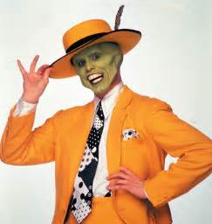
Lets get ready Year 10’s
Bag to the front
Equipment out (pencil, book, calculator, ruler)
Sitting in your assigned seat

Slide 2
Mental set On the left hand side please!
6x13 =
2. 53+68 =
3. 61-47=
4. 31-53=
5. 4cm x 3cm x 5cm =
6. 6m x 2m x 200cm =
7. 100cm x 3000mm x 2m =
8. 0.5 x 2m x 3m x 8m =
What is the probability that Mr Morgan is taller then 6 foot?
10. What is the Probability of the Geelong Cats winning the Premiership?
Notes:
hook

Slide 3
24
7
30
Date
Probability
EQ –How do I calculate probability of a single event?
5
Notes:
Lesson objective (EQ)

Slide 4
Lesson objective
By the end of this lesson you will be able to;
- Calculate the probability of a single event.
Notes:
Lesson

Slide 5

Class
Left hand side….
As a class create a list of words/ phases that relate to the probability of something happening/ not happening? Here are a few to get you started.
Buckley's chance
Dead set certain
Possible

Slide 6
24
7
30
Probability of a single event?
Date
EQ – How do I calculate probability of a single event?
Probability Formula
What is probability
What is theoretical
Probability?
What is Experimental
Probability?
The difference between theoretical and experimental?
Probability = Number of possible outcomes
Total number of outcomes
How likely something is to happen/not happen.
Many events can't be predicted with total certainty. The best we can say is how likely they are to happen.
Theoretical probability is the probability of an event when all outcomes are equally likely.
Experimental probability is the ratio of the number of times an event occurs to the total number of trials or times the activity is performed.
Experimental probability is the probability determined in practice. Theoretical probability is the probability that should happen by the book.
5
Notes:
Input

Slide 7
Check for understanding
Probability = Number of possible outcomes
Total number of outcomes
What is the probability of someone rolling a even number on a six sided die?
What is the probability of someone rolling a 5 on a six sided die?
What is the probability of flipping a coin and getting a tail?
Explain if your answers would change if you did experimental probability?
Notes:
Check for understanding

Slide 8
Activity
Mrs Miller offers Mr Morgan her bag of skittles. In this bag are the following skittles 6 green , 5 yellow, 3 red, 8 purple and 4 orange.
What is the probability Mr Morgan picks a red skittle?
Probability of picking a green or purple skittle?
Probability of not picking a yellow skittle?
Probability of picking anything but an orange skittle?
Notes:
Independent practice

Slide 9
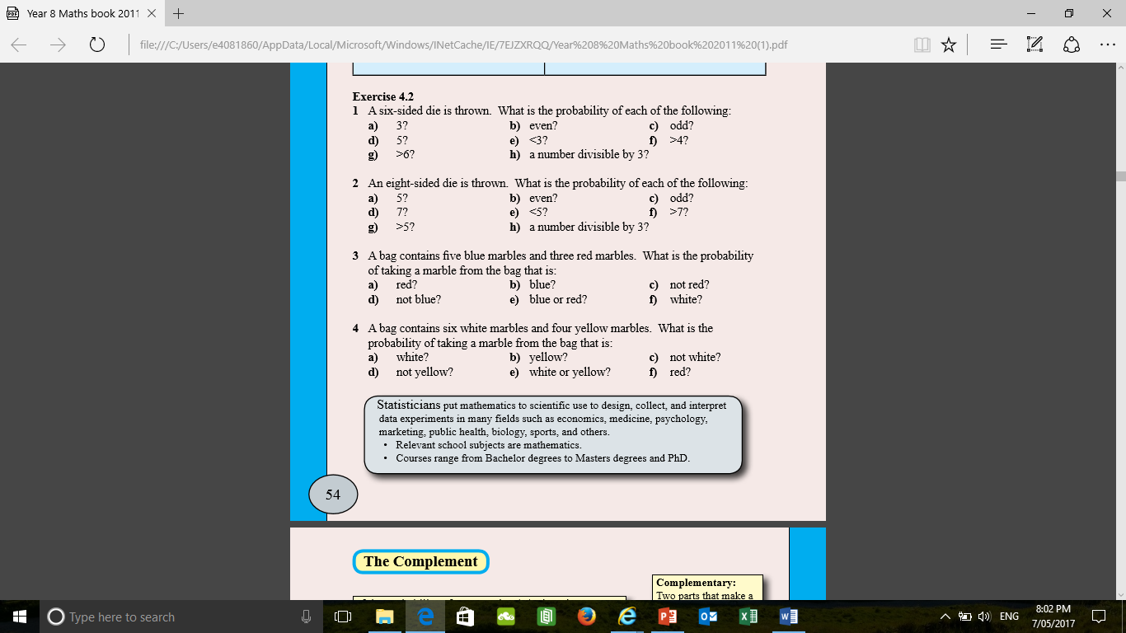
Practise Time Lets see what you can do.

Slide 10
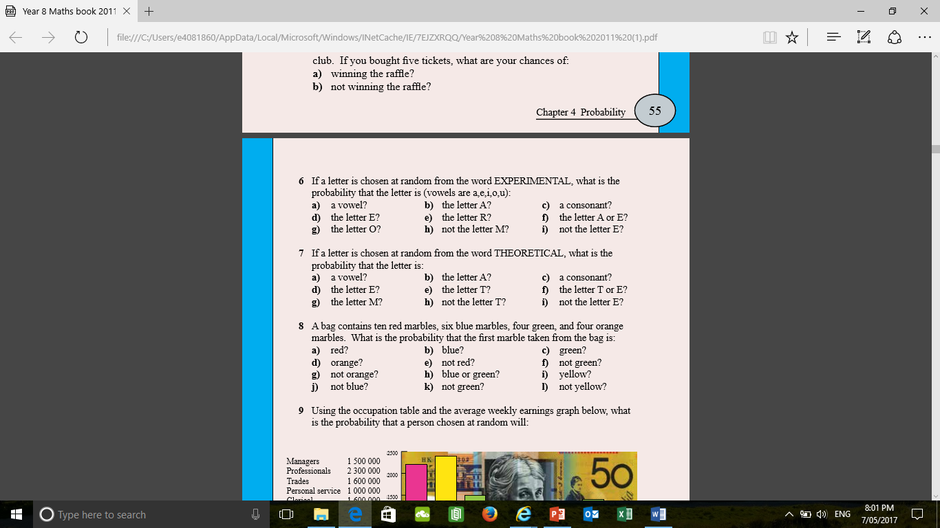

Slide 11
Thumbs up, down or sideways Checking for Competency
Thumbs up – I got it, this makes sense. I'm the bomb.com.
Thumbs sideways –I need a little more practise before I'm ‘rockin’ this.
Thumbs down – I still don’t quite understand probability I need a little more help.
Notes:
Closure

Slide 12

Tutoring
Every Thursday afterschool be there or be

Slide 13
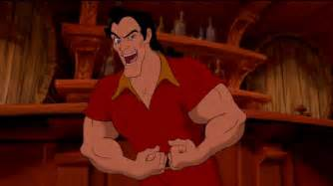
Thankyou and have a Wonderful Day
Trivia Question – Name that movie?

